Slide 1
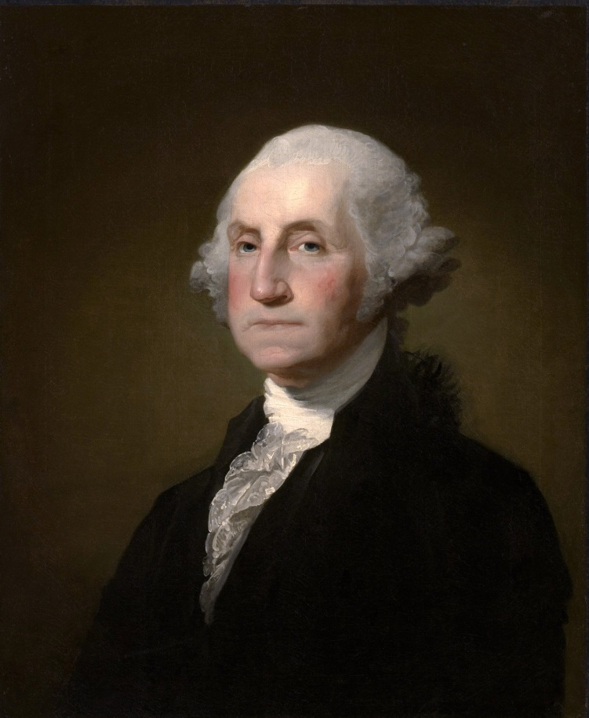
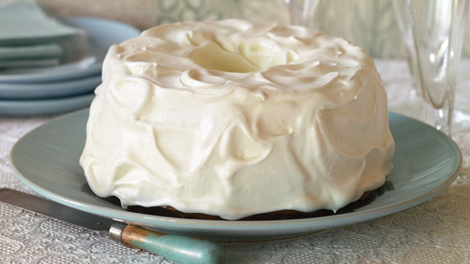
Great Cake
1. George Washington

Slide 2
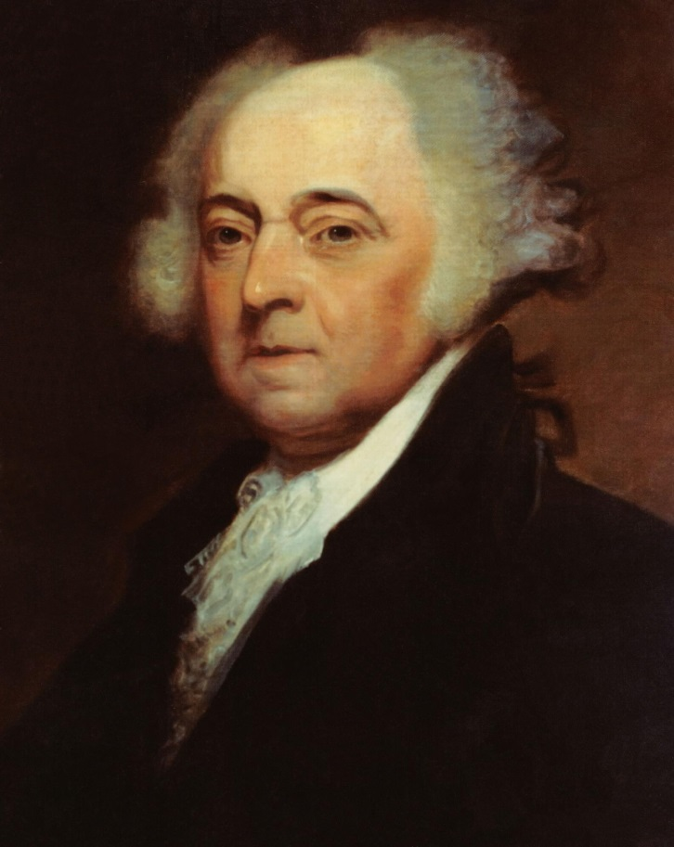
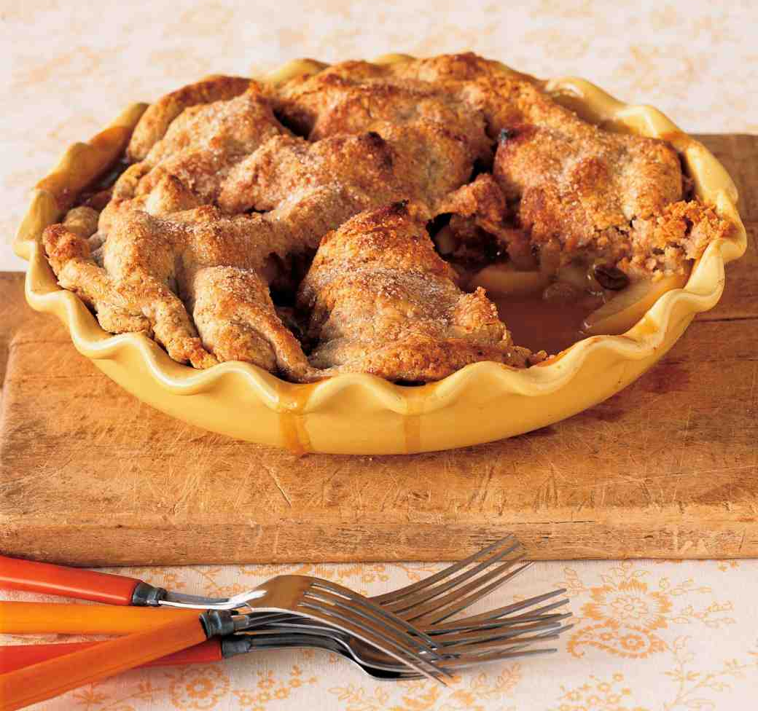
Apple Pan Dowdy
2. John Adams

Slide 3
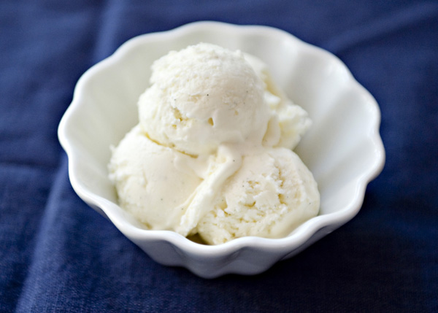
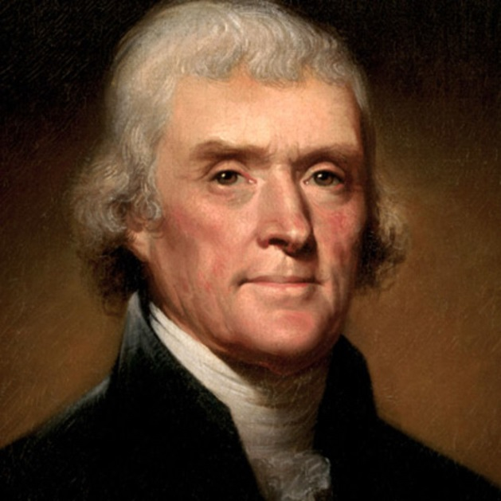
Vanilla Ice Cream (his recipe at left)
3. Thomas Jefferson

Slide 4
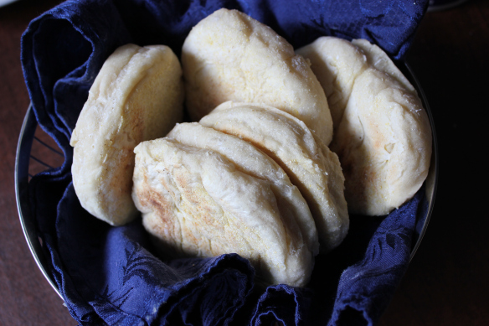
Monticello Muffins
3. Thomas Jefferson

Slide 5
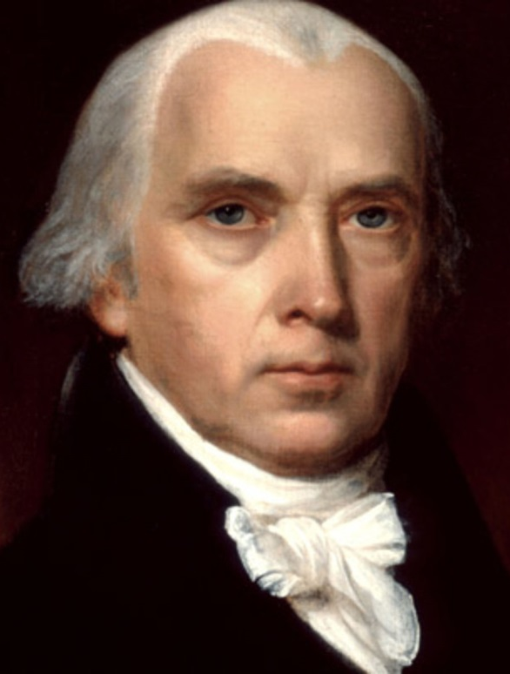
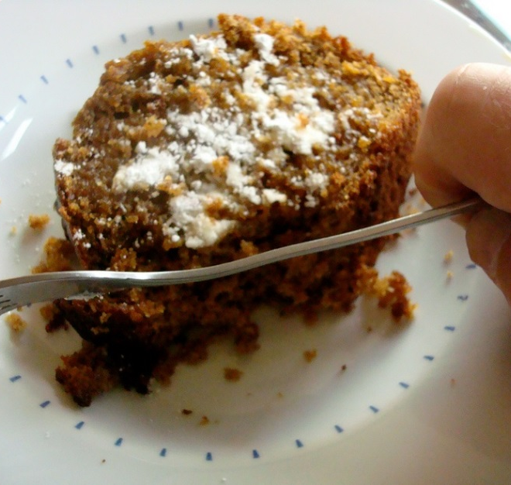
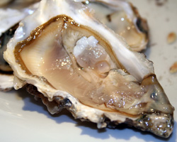
Gingerbread Oyster Ice Cream
(also Cinnamon Woodbury Cake)
4. James Madison

Slide 6
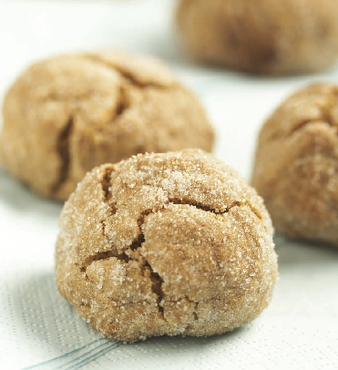
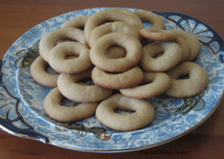
Cry Baby Cookies Cream or Waverly Jumbles
5. James Monroe

Slide 7
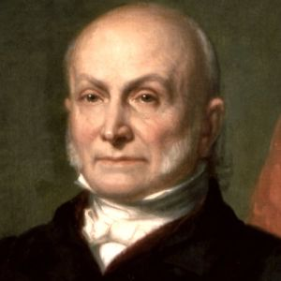
Soft Molasses Cakes (cookies)
6. John Quincy Adams

Slide 8
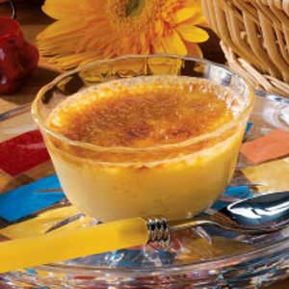
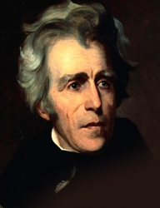
Burnt Custard
7. Andrew Jackson

Slide 9
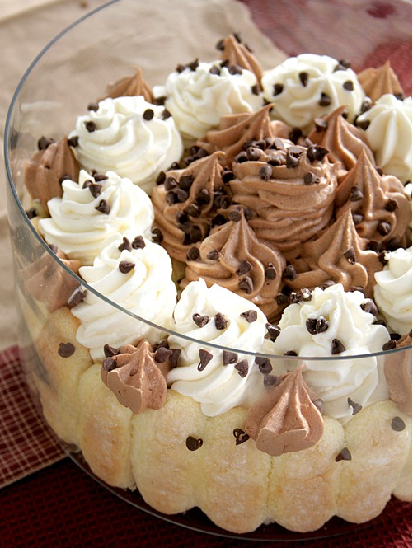
Charlotte Russe
8. Martin Van Buren

Slide 10
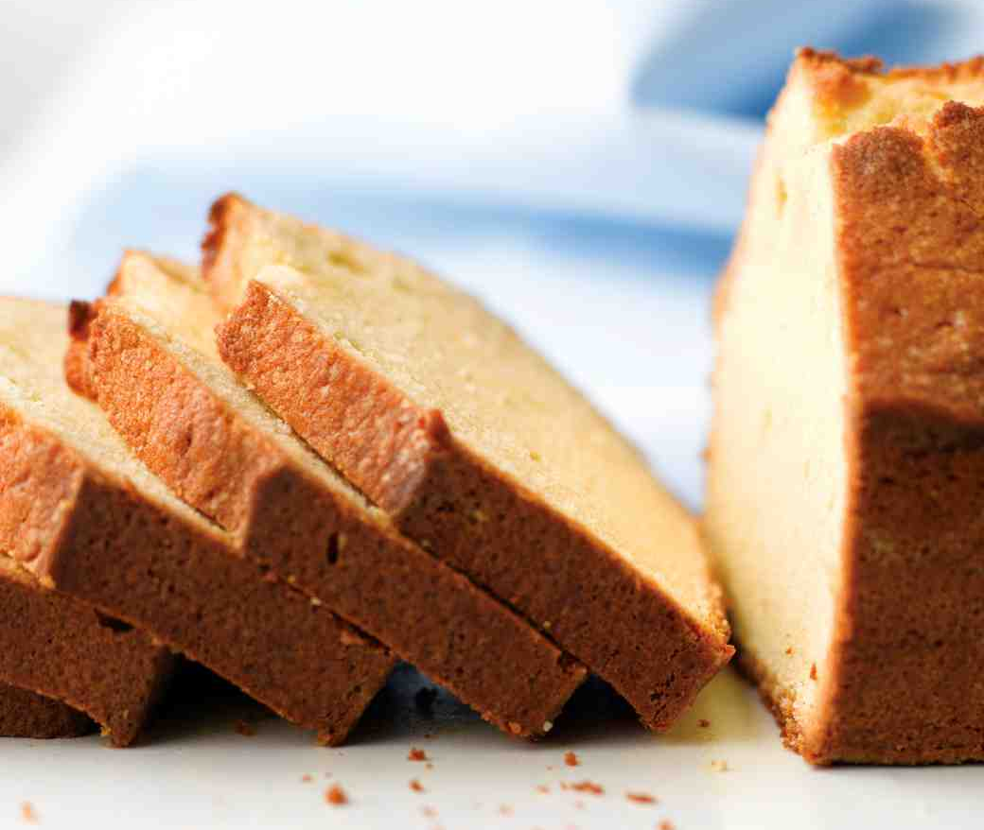
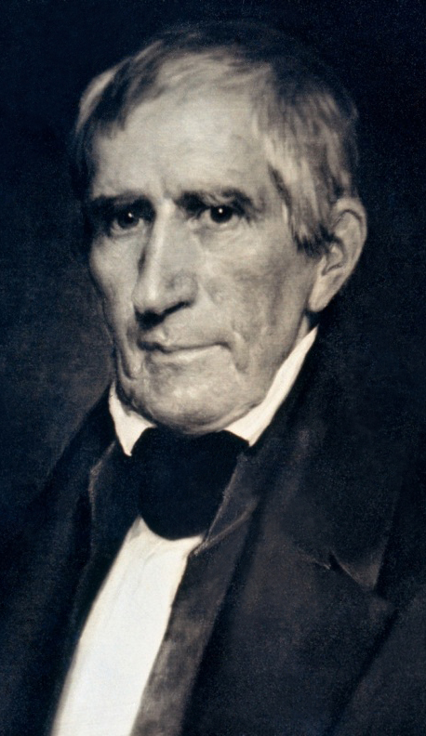
Pound Cake (better eat it quick – faster than 32 days!)
9. William Henry Harrison

Slide 11
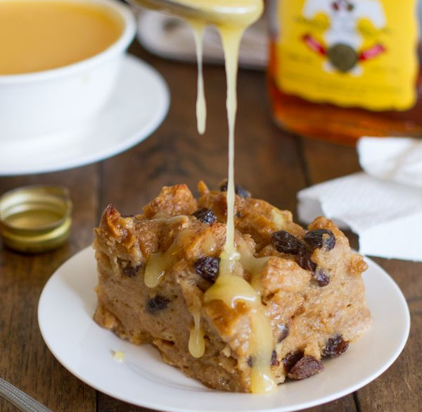
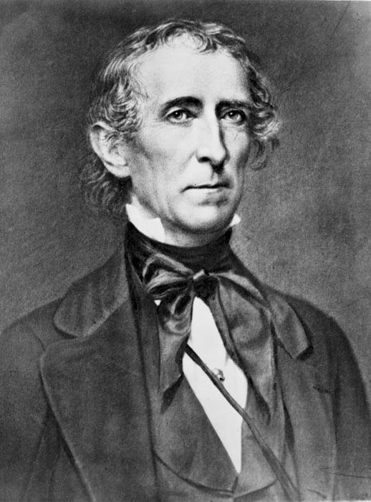
Grateful Pudding (Bread Pudding with Rum Sauce)
10. John Tyler

Slide 12
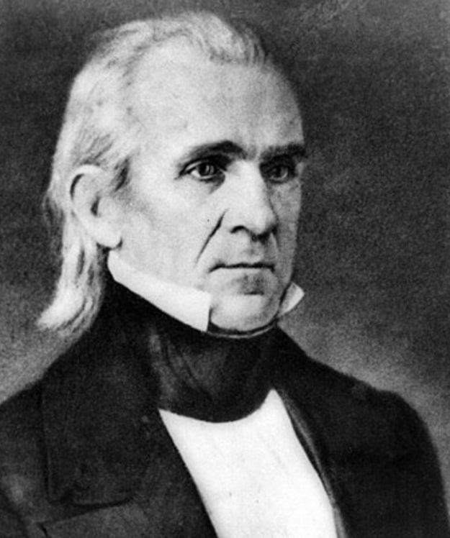
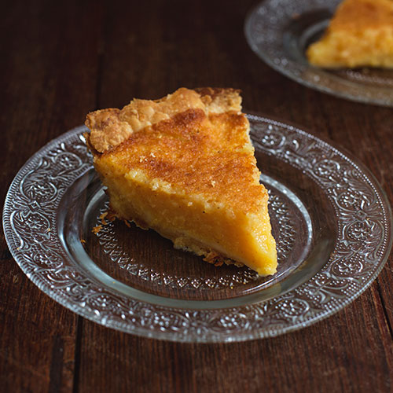
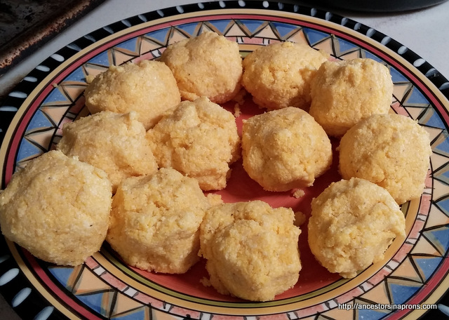
Vinegar Pie Corn Pones
11. James K. Polk

Slide 13
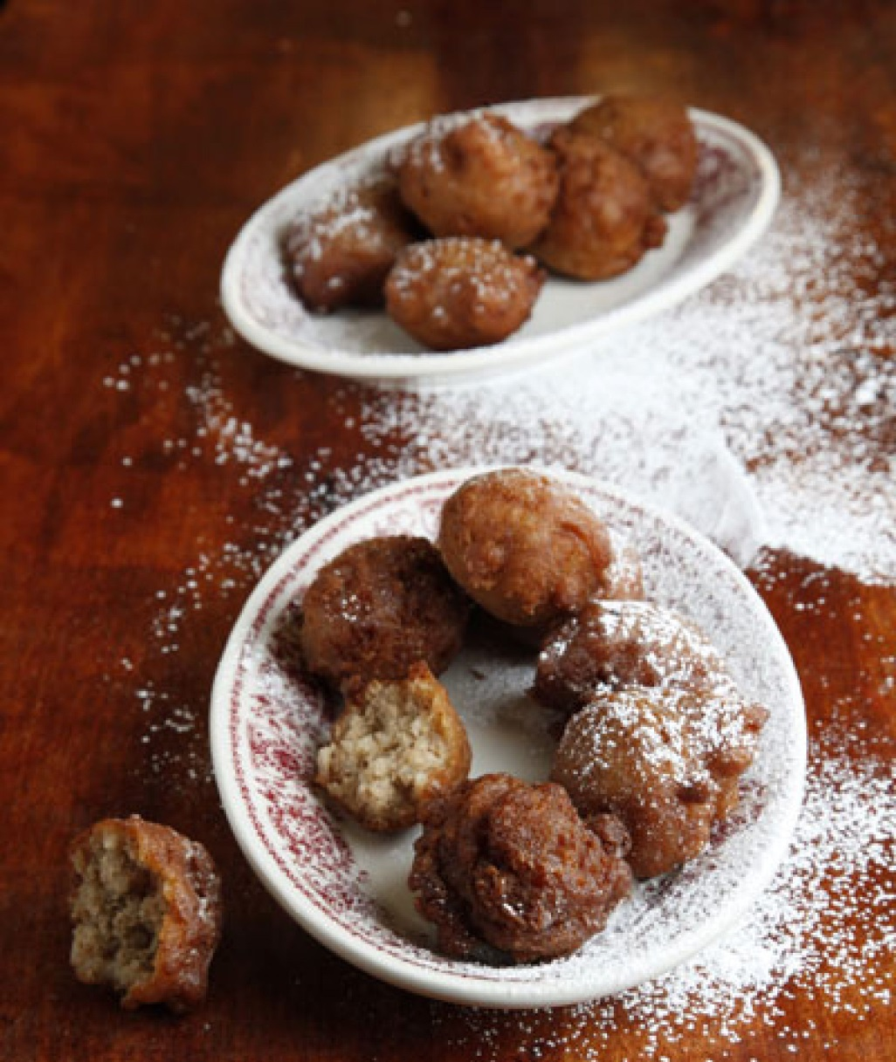
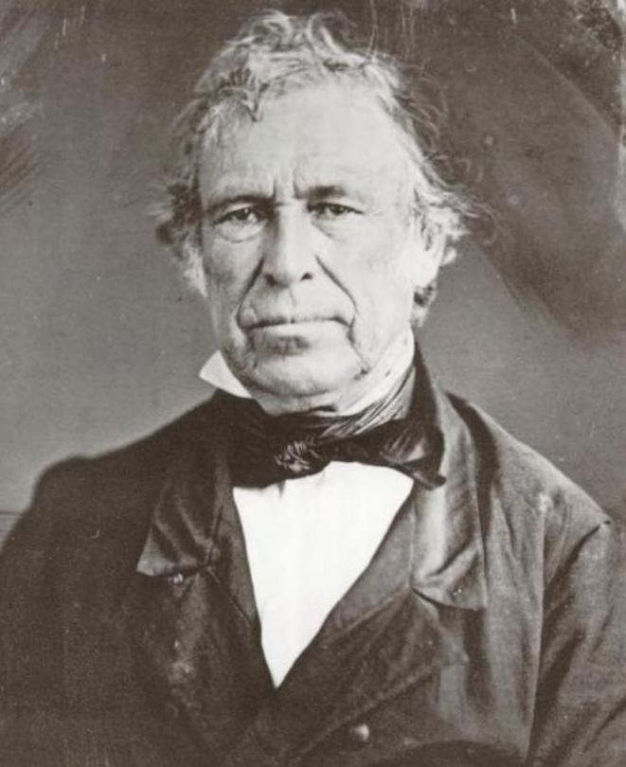
Calas-Tous-Chalads (Sweet Rice Fritters)
12. Zachary Taylor

Slide 14
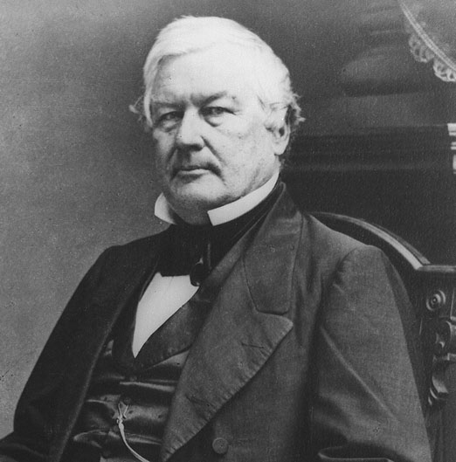
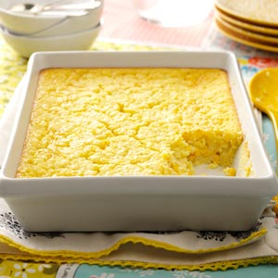
Corn Pudding
13. Millard Fillmore

Slide 15
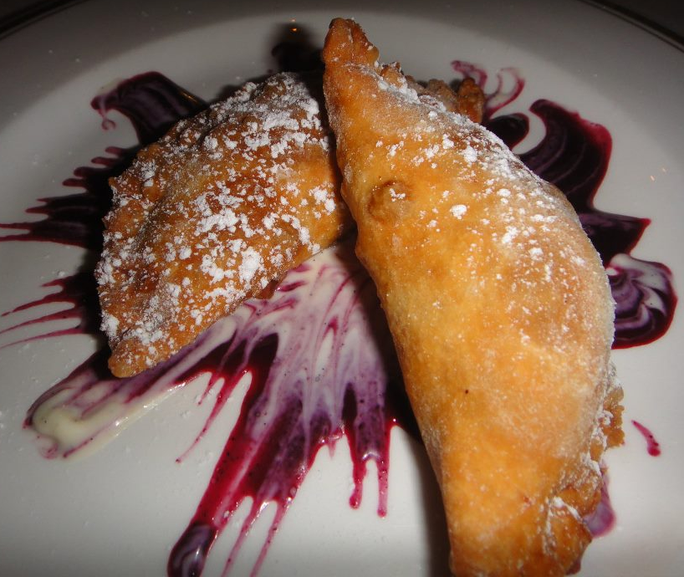
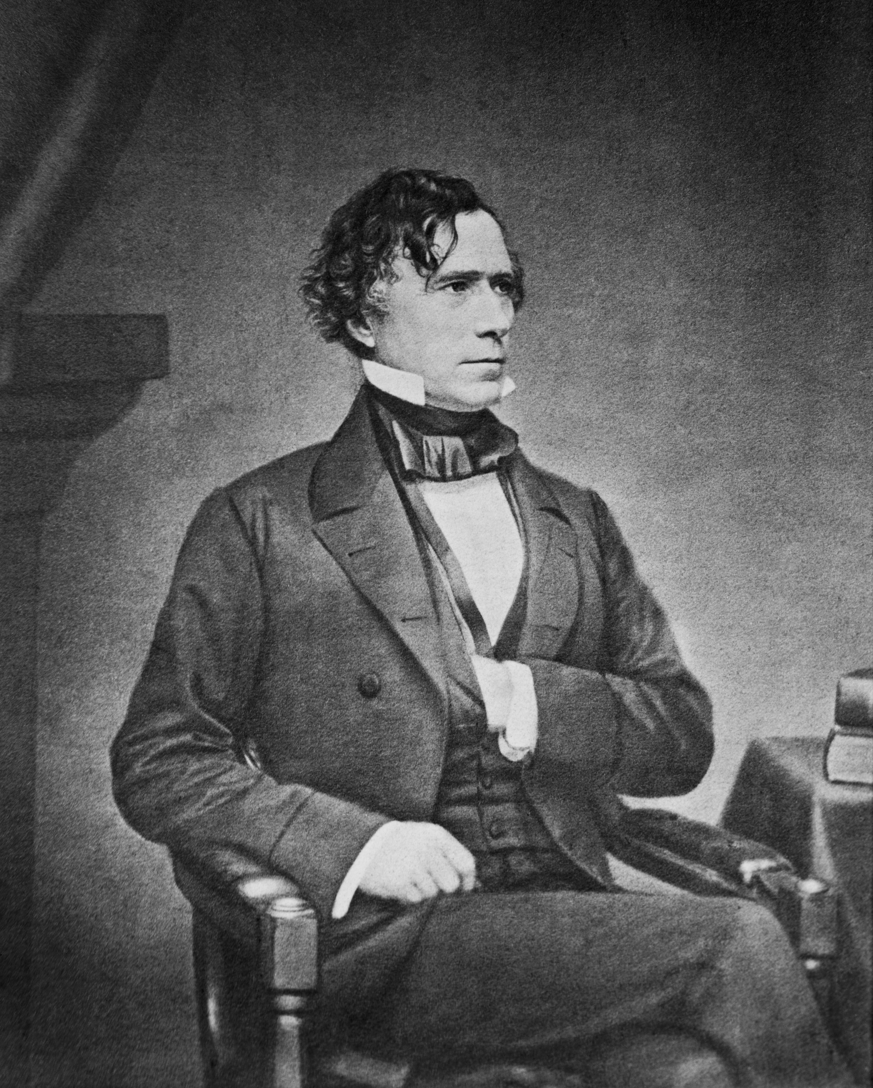
New Hampshire Fried Pies
14. Franklin Pierce

Slide 16
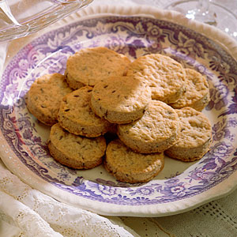
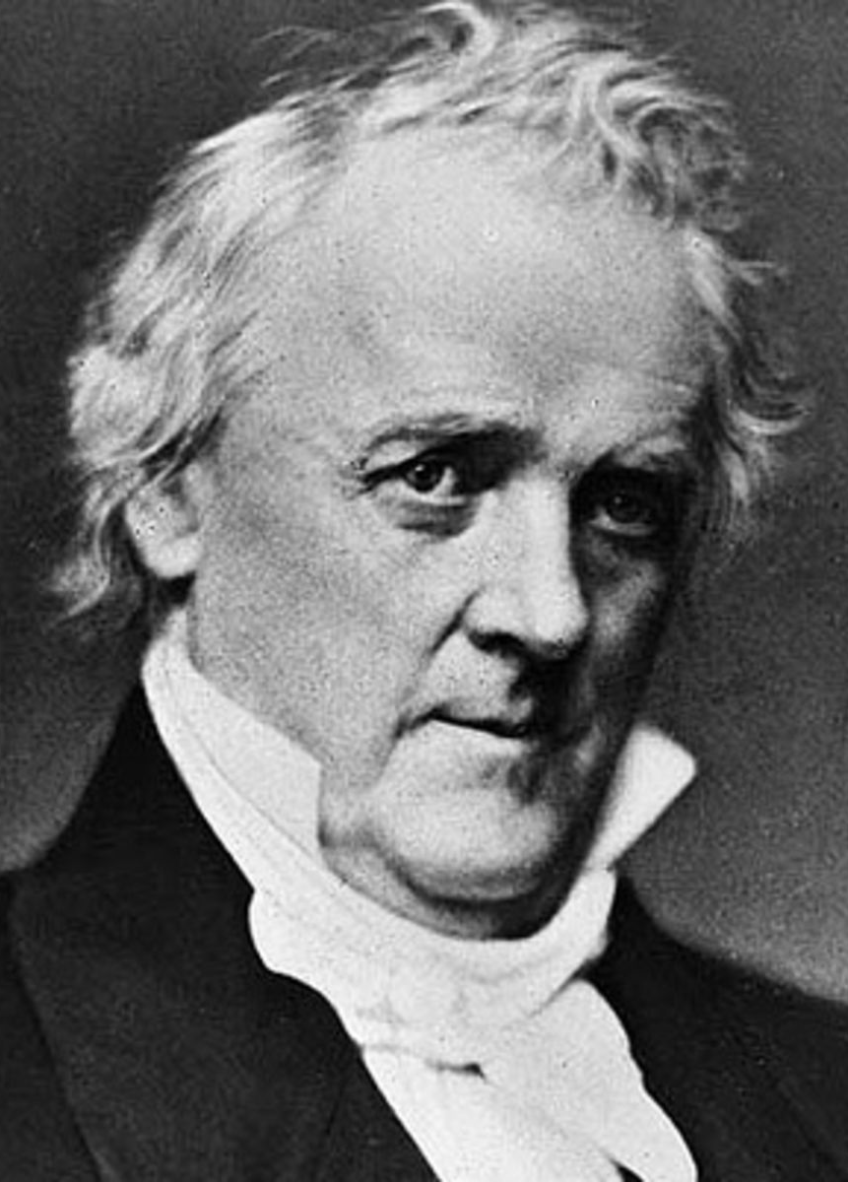
A-Pee Cookies
15. James Buchanan

Slide 17
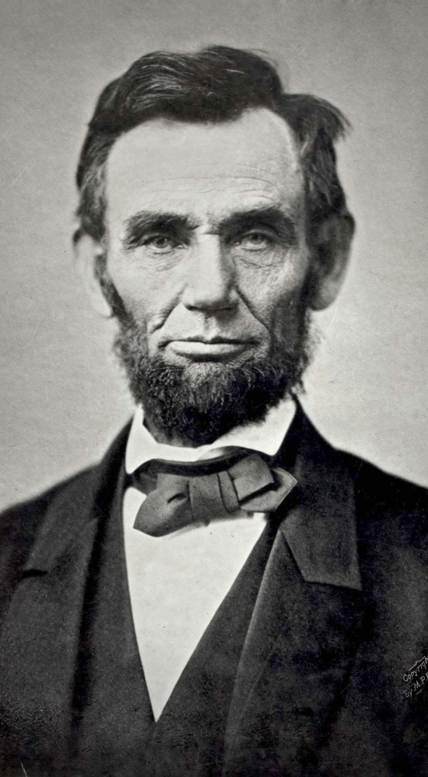
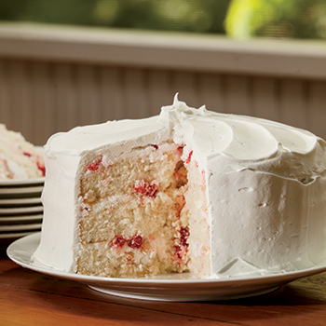
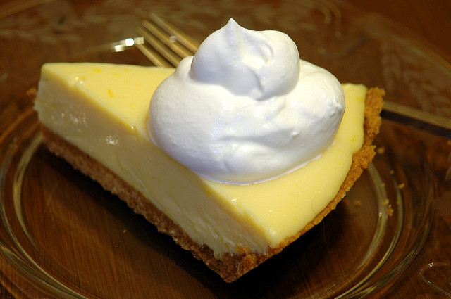
MTL’s White Cake Lemon Custard Pie
16. Abraham Lincoln

Slide 18
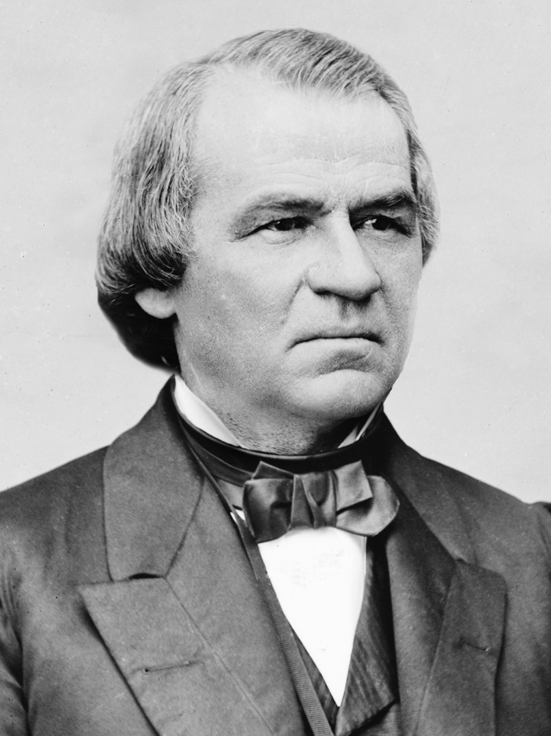
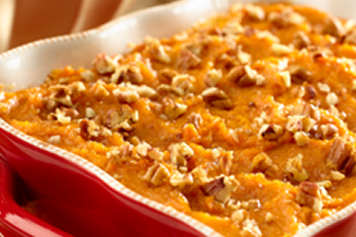
Sweet Potato Pudding
17. Andrew Johnson

Slide 19
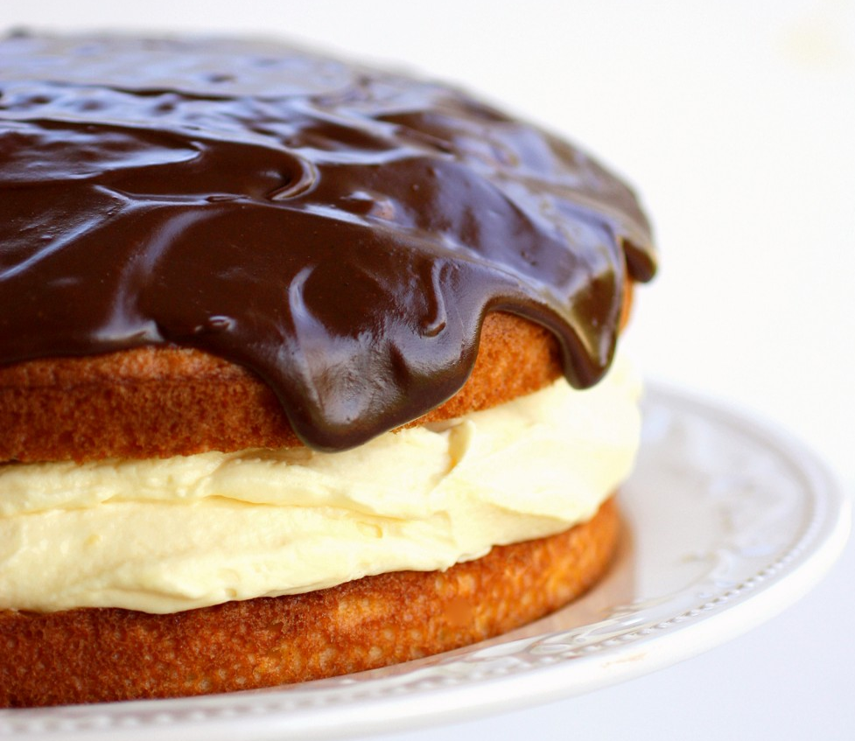
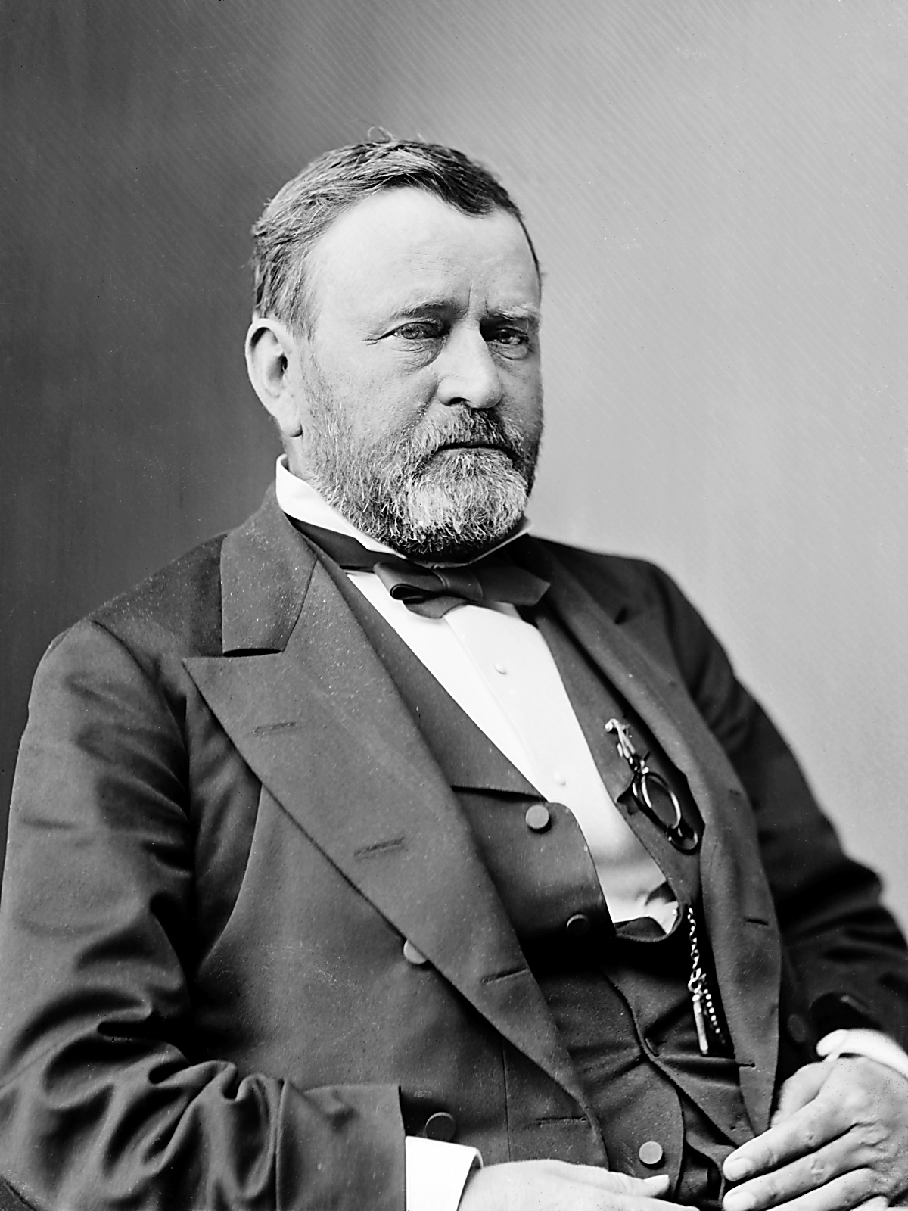
Boston Cream Pie
18. Ulysses S. Grant

Slide 20
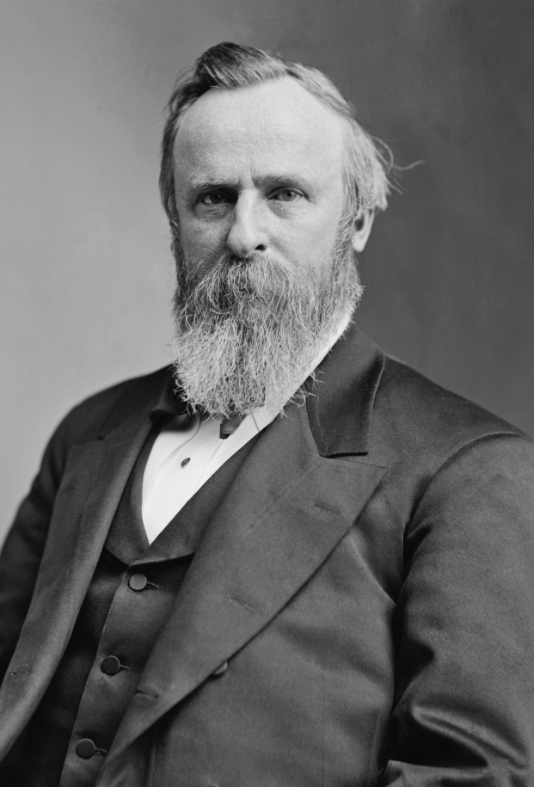
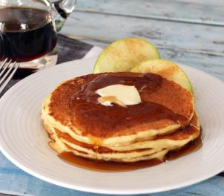
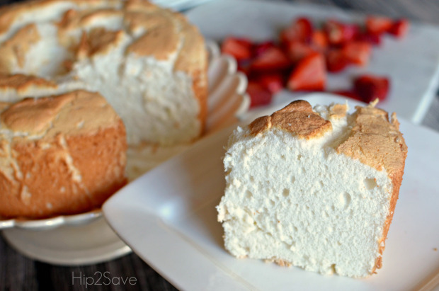
Angel Food Cake Cornmeal Battercakes
18. Rutherford B. Hayes

Slide 21
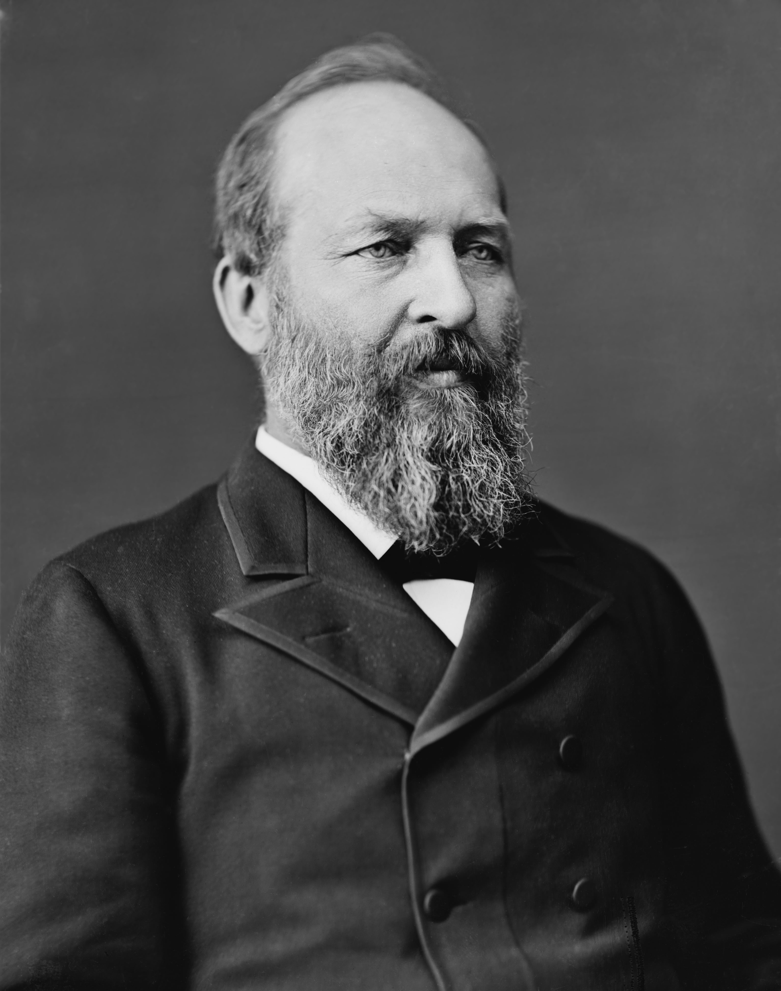
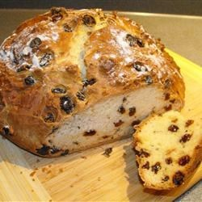
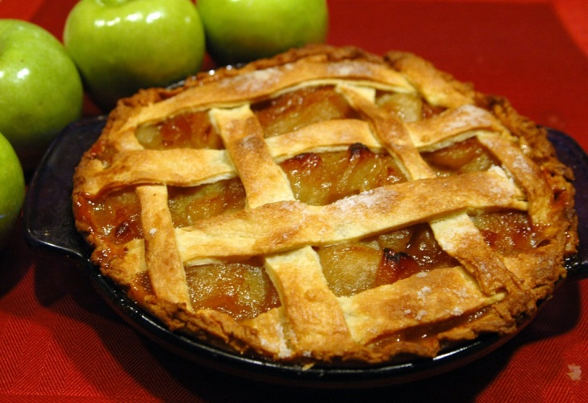
Apple Pie Soda Bread
20. James A. Garfield

Slide 22
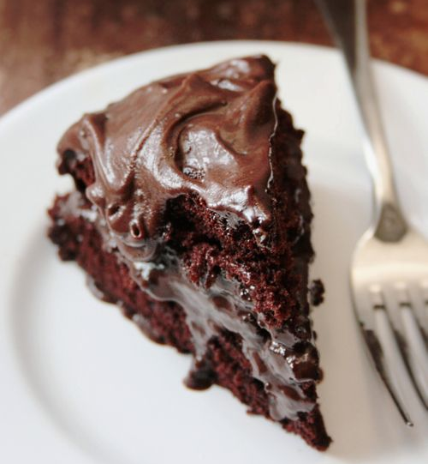
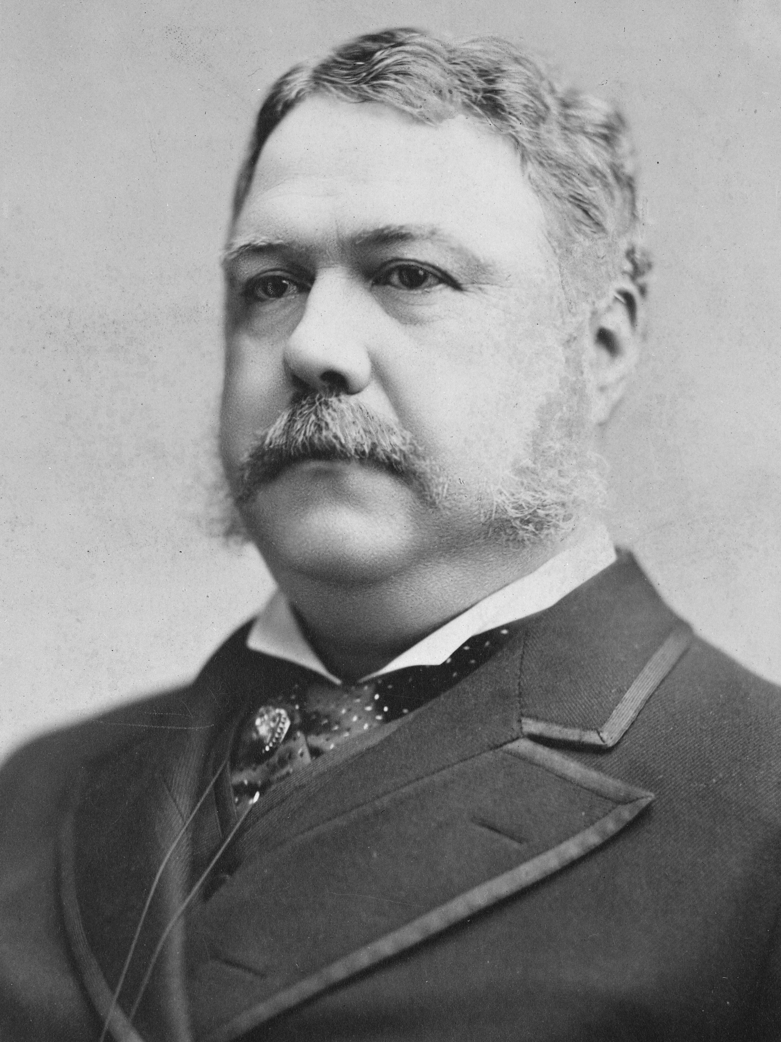
Devil’s Food Cake
21. Chester A. Arthur

Slide 23
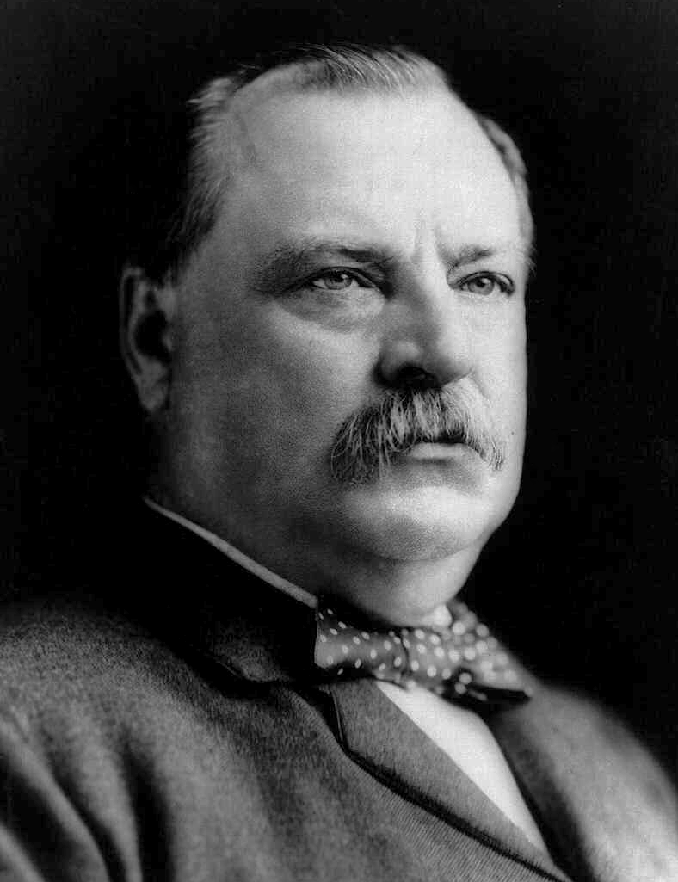
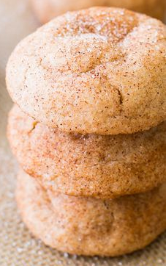
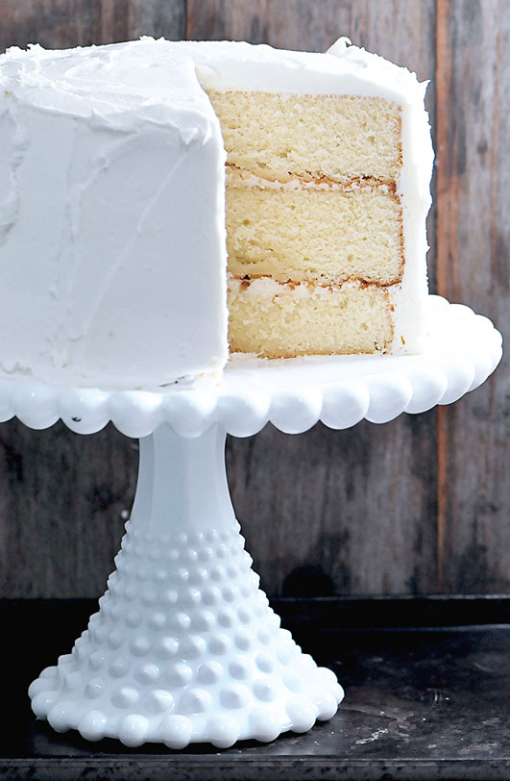
Snickerdoodle Cookies White Cake with Frosting
22. and 24. Grover Cleveland

Slide 24
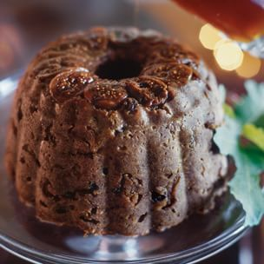
Fig Pudding
23. Benjamin Harrison

Slide 25
Eggs (eggs for breakfast, eggs for lunch, eggs for dinner)
25. William McKinley
McKinley was a very simple eater with no known favorite dessert

Slide 26
Fat Rascals Sagamore Hill Sand Tarts
26. Theodore Roosevelt

Slide 27
Pumpkin Pie (and lots of it)
27. William Howard Taft

Slide 28
Tea Cakes
28. Woodrow Wilson

Slide 29
Almond Cookies
29. Warren G. Harding

Slide 30
Maple Walnut Cookies Ice Box Cookies
30. Calvin Coolidge

Slide 31
Cream Peach Pie
31. Herbert Hoover

Slide 32
Angel Food Cake with Pink Clouds Blueberry Pudding Cake
32. Franklin D. Roosevelt

Slide 33
Ozark Pudding Cake Butterscotch Cookies
33. Harry S Truman

Slide 34
Million Dollar Fudge Chocolate Marble Cookies
34. Dwight D. Eisenhower

Slide 35
Waffles Cream Cheese and Frozen
Strawberry Delight
35. John F. Kennedy

Slide 36
Pecan Pie Chocolate Nut Drop Cookies
36. Lyndon B. Johnson

Slide 37
Yorkshire Pudding White House Cookies
37. Richard M. Nixon

Slide 38
Butter Pecan Ice Cream
38. Gerald R. Ford

Slide 39
Peanut Butter Pie
39. Jimmy Carter

Slide 40
Jelly Belly Jelly Beans Coconut Macaroons
40. Ronald Reagan

Slide 41
Chocolate Chip Cookies
41. George H.W. Bush

Slide 42
Oatmeal Cookies Chocolate Chip Cookies
42. Bill Clinton

Slide 43
Buttermilk Coconut Cream Pie Apple Cider Crème Brulee
43. George W. Bush

Slide 44
Crustless Coconut Pie
44. Barack Obama

